Slide 1

PREDICTING THE ENERGY OUTPUT OF WIND TURBINE BASED ON WEATHER CONDITION
MONITORING OF WIND TURBINE

Slide 2
Using Internet Of Things To Predict Wind Energy In future the world’s most of the energy demands are mainly depends on renewable energy, as such one the wind energy gains greater attention in research area and practices and when compared to other renewable sources it has possibilities like ecofriendly, negligible wastes, get a clean energy and so on. But most of the problems faced by wind turbines are structural faults. The internet of things IOT is a new and future technical paradigm and there are so many researches and studies are going on this field and researches says that in future the IOT becomes an unavoidable one in day to day life like electricity. In this paper proposes a real time monitoring and fault diagnosis technique for wind turbine using IOT enabled. Through this model live status monitoring, early fault identification and analysis of historical status of turbine are made possible.

Slide 3
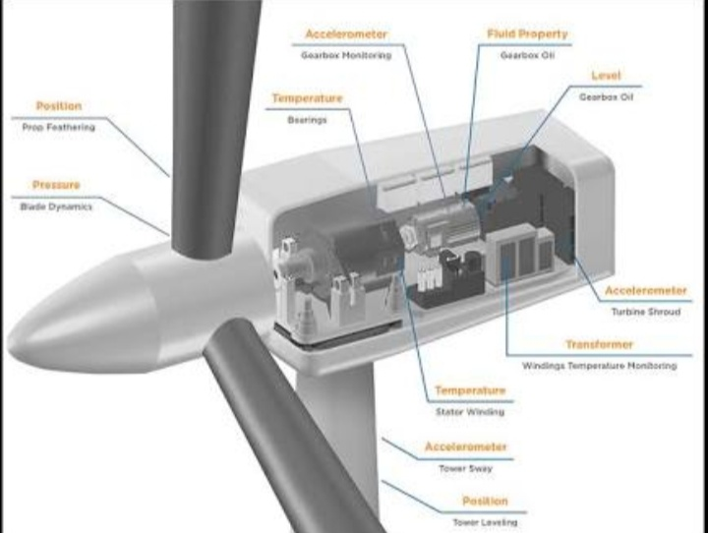
Real Time Monitoring Of Wind Turbine Using IOT Enabled Approach Smart turbine In this model a smart turbine is build i.e., the arrangement of turbine with required sensors attached on its various parts in a suitable manner and along with these sensorsVibration sensor, temperature sensor, torque sensor and force sensor are the sensors used here, vibrations sensors are attached on the bearings and blades whereas the
temperature sensor plays
its role in generator and
rotor, the torque sensor
also used in rotor and
force sensor attached
with blades. .

Slide 4
The real time status of wind turbine is tracked and traced with the help of data’s collected by these sensors so the turbine is always under 24*7 monitoring
TEMPERATURE SENSOR Temperature sensor is a device that generates electrical voltage which is directly proportional to changes in temperature for temperature measurement. LM35 is a precision IC temperature sensor with its output proportional to the temperature. Temperature sensor is frequently provided in IC to detect when the operating temperature limits have been exceeded.
HUMIDITY SENSOR
Humidity sensor is a device in which its impendence can be changed with the related humidity.
Polymer humidity sensor is made of a thermosetting resin based on AL203 ceramic.

Slide 5
VIBRATION SENSOR A piezoelectric sensor is a device that uses the piezoelectric effect to measure pressure, acceleration,strain or force by converting them to an electrical signal. Vibration sensor can also be used to harvest wasted energy from mechanical vibration.
SPEED FORMULATION The speed/RPM sensors are built, based on various determining principles Hall Effect, magneto resistive, inductive to detect without getting a hold of the rotary movement of phonic or toothed wheels and usually of any rotative device fabricated in a ferrous material and provided with slots or obtrusive parts. They provide a frequency output signal which is digital in nature for the Hall effect or magneto resistive versions or a sinusoidal
signal for the inductive versions that pursue exactly the

Slide 6
alternating sequence of presence and absence of ferrous material presented by the rotative device[9].Speed=RPM/Voltage Where, V - Voltage, RPM- Revolutions per Minute
Smart connection
The data’s collected by sensors are received by a central server i.e., the smart turbine is connected to a central computer, for this a connectivity layer is need here it is termed as smart connection. This work use Wi-Fi as a smart connection for connect the sensors and server, while the RF tags are connected to the server by using a RF way of communication and 4G connection is used for access the server by user’s smart phones. In this smart connection it is also possible to control and manage the connectivity methods by central computer effectively

Slide 7
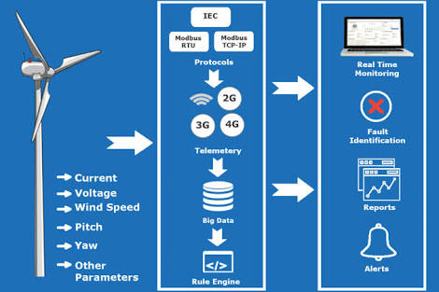
and efficiently, hence it is reliable to capture and collect the real time data’s.
Smart data model To ensure the full use
captured and collected
data’s, it is necessary for
process and analyze it,
for this data models are
used. This data model layers classify and standardize the collected heterogeneous data to a formatted scheme by processing and analyze it, this formatted scheme is used for real time status identification and decision making. MTconnected, STEP and XML are the data models suggested here. By using these data models complete utilization of collected turbine parameters is done.

Slide 8
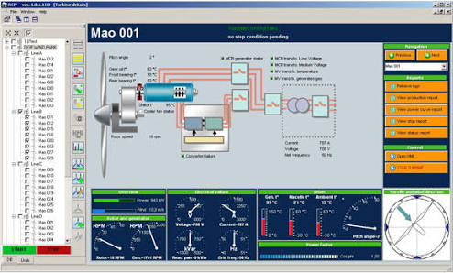
Smart view For monitor the real time
parameters of wind turbine
by end user’s this layer is
used. In smart view the
data’s captured by various
sensors are visualized to
the end user graphically
like in the form of pie chart
or bar chart, so the user
can easily recognize the
current status of turbine. Here not only shows the live data’s but also the user can able to check the historical data status of turbine, it helps to take advanced decisions. The registered users can also able to see the status of turbine by using their smart phones.

Slide 9
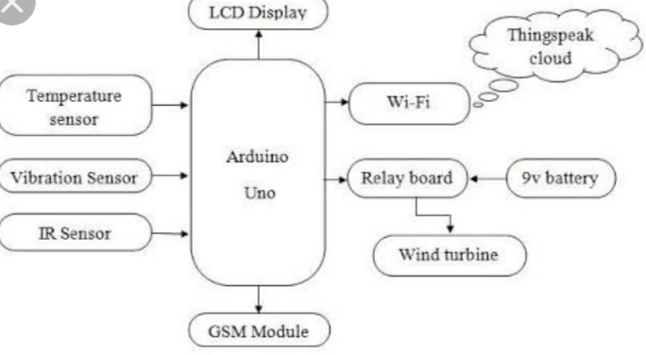

Slide 10
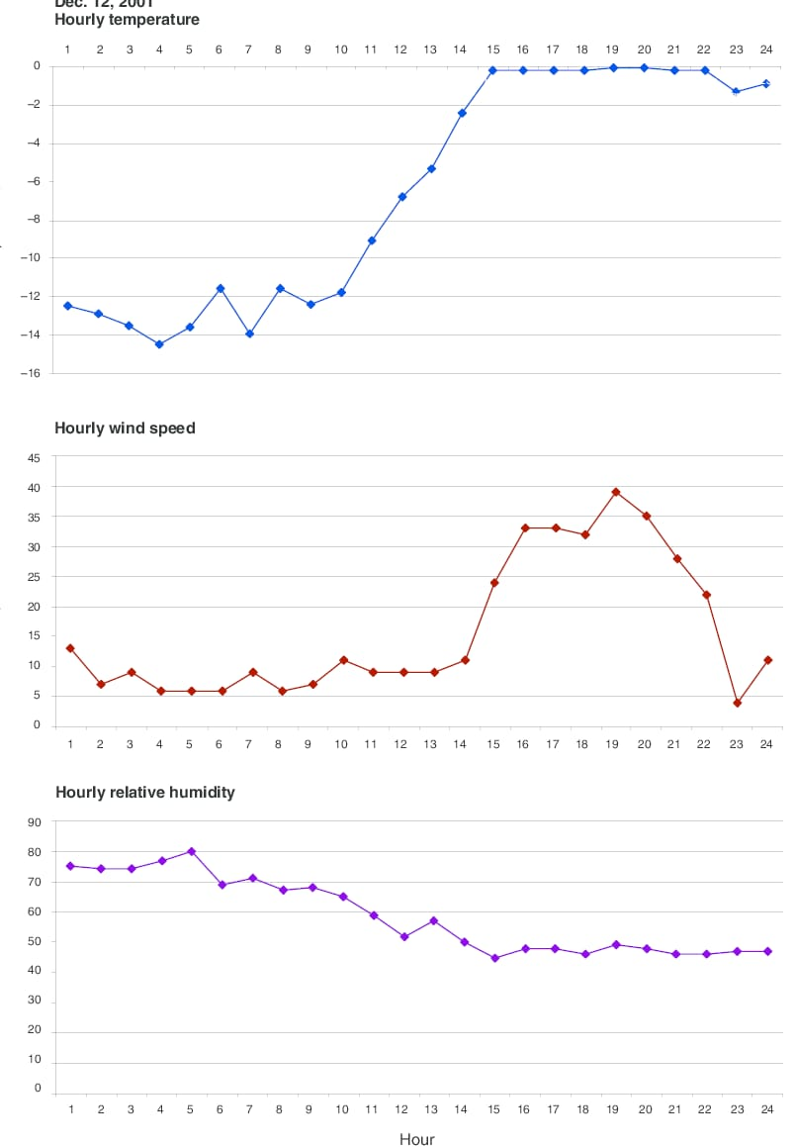

Slide 11
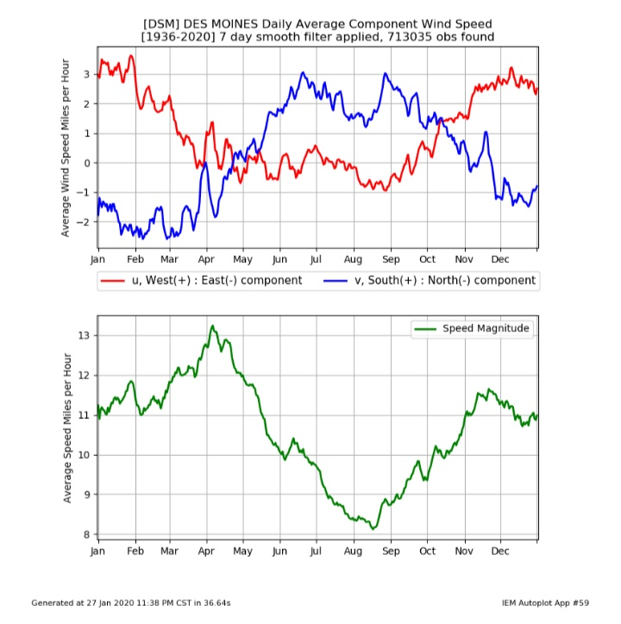

Slide 12
THANK YOU

